Slide 1

DriverPass System Analysis
Kevin Portillo

Slide 2

System Requirements
Functional Requirements
Account Management System
Completion/Tracking System
Nonfunctional Requirements
Operational
Security
Notes:
A functional Requirement for DriverPass will be making sure we have an Account Management System. The system shall be able to create accounts for all the students. This will apply to the Instructors, helpers and Administrators. The system should be able to log everyone In and Out successfully. Another Functional Requirement will be the Completion and Tracking System. The Instructors should be able to see the progress of the students. Send alerts to students that are falling behind. The students will also be able to see the progress of their work.
A nonfunctional Requirement will be the operational or how the system will work. The system should be able to work with all the operating systems(Mac, Windows, Google, etc. ). The system will be able to work on any web browser(Google, Safari, Edge etc.). Another nonfunctional Requirement will be security. Only authorized users will be able to make changes. The main manager will be the only one to oversee everything.

Slide 3
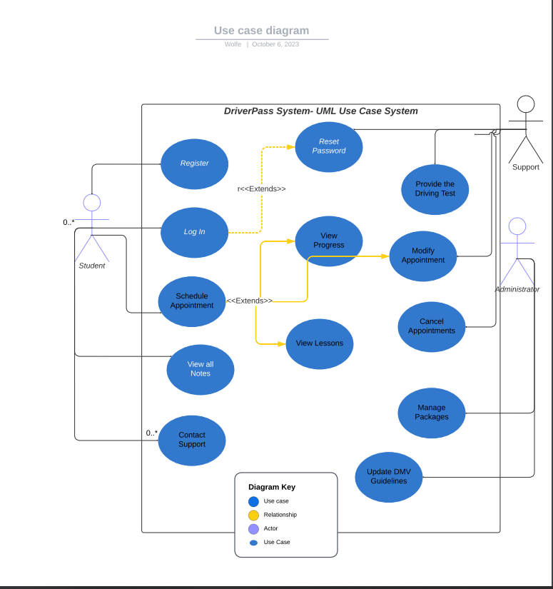
Use Case Diagram
Notes:
The different actors or users in the system would be The Student, Instructor, Administrators, helpers. Each user will have different access to do in the DriverPass project. The students should only be able to do the basic, like checking their scores, assignments, Scheduling an Appointment, and to contact support. The Administrators would be able to modify accounts, remove/add accounts, and to update the DMV guidelines. The helpers will just be there to help students with any problems with their scheduling of Driving Test. The Instructors will be able to administer the lessons and to see what students will need to talk the driver test.

Slide 4
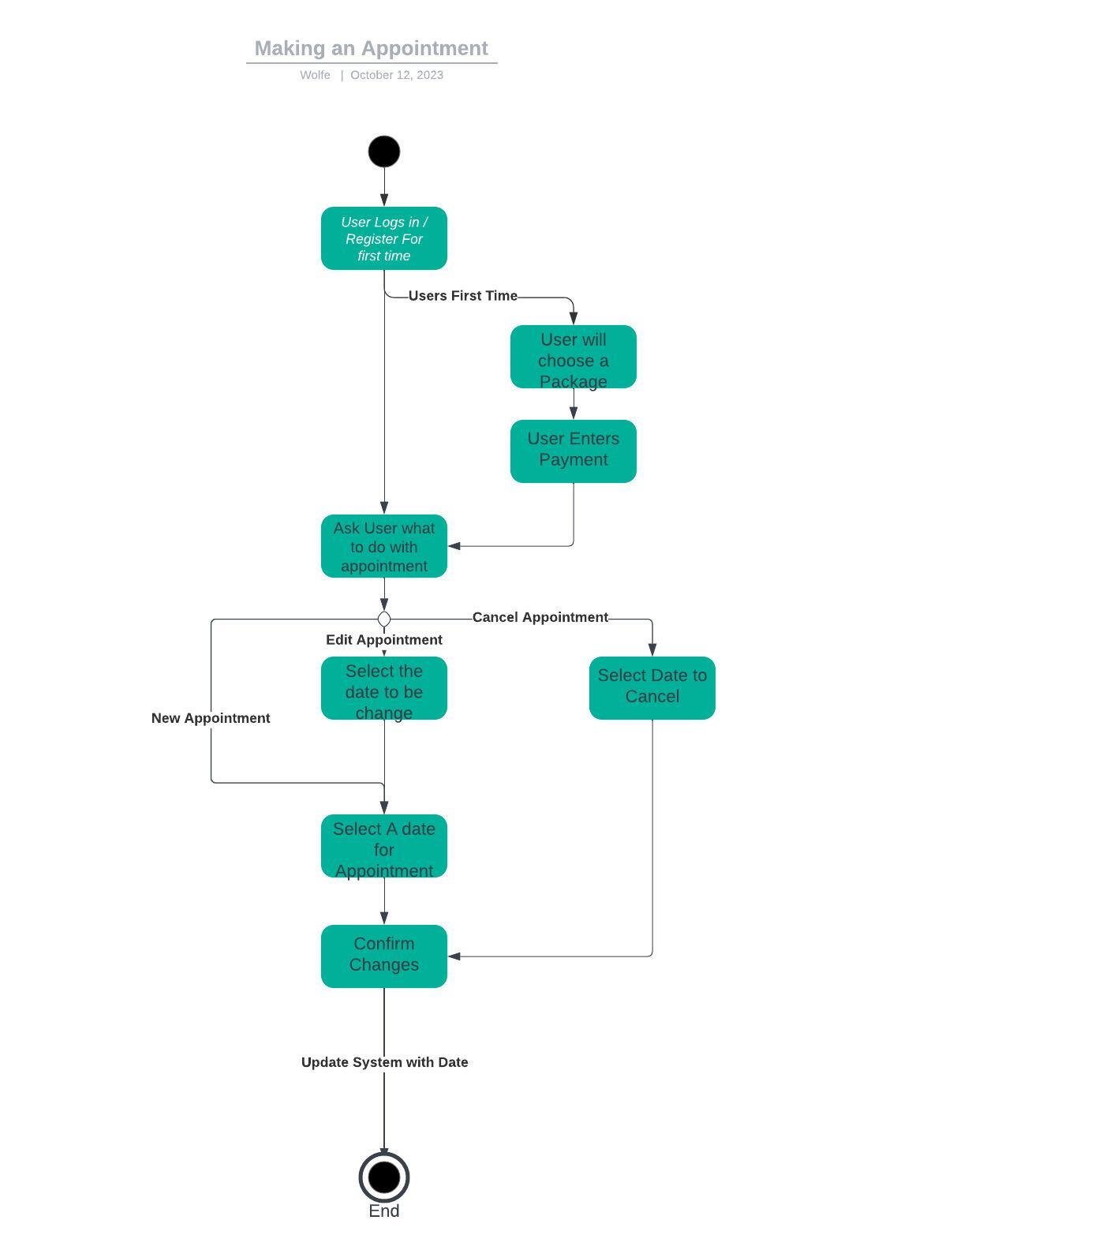
Activity Diagram
Notes:
In this diagram it shows how a student would make an appointment. We start with the user logging in or signing up. If it’s a new user, they will have to chose the package which they want to sign up. Then the user will see in the screen to make or edit appointment. If the user want to create a new appointment it will show all the available days to take the test. When the user want to edit the days, it will also show the days available to change. The user will confirm the appointment and then the helper will confirm with the instructor with the date. To determine the dates available will be the number of cars available and the number of students for that day.

Slide 5
Security
Only Authorized people will be able to modify the Website
Instant notification to management if security fails.
Back up on all files
Constant security updates
Notes:
First the only persons allowed to change anything on the website would be the authorized people. Management and Administrators. There would be an instant notification for any attempts to bring down the website. We would have all the files backed up if something were to happen to the website. We will be constantly updating the security features on the website to make sure we are up to date with any type of security attack.

Slide 6
System Limitations
Internet Connection
Operating Systems
Web Browsers
Mobile Devices
Notes:
There might be some roadblocks that may affect how the system will work. One will be the internet Connection. When the user has great connection, the website will be able to respond to loading the whole page efficiently. It needs to have a good connection to be able to load the test properly and to be able to read or watch the lessons made from the instructor. Slow internet may cause a problem for the user going through our system. Another limitation would be the Operating systems. There are popular operating system like Windows and Apple IOS, there are some others that people will use. The system must be able to run in these different systems that may or may not work as intendent. The same goes with web browsers. It may not load the webpage correctly. There are also many types of mobile devices like Android phones, iPhone, tablets of different sizes. Since it is always updating every year, there needs to always be updating to work on the current devices.

